Slide 1
Elliptic curve cryptography based mutual authentication scheme for session initiation protocol
Presented by:
Shivika Malik (001346591)

Slide 2
Introduction
SIP is widely used signaling protocol for controlling the communication on the internet, maintaining, establishing as well as terminating the sessions.
It works on the application layer which can create, modify and terminate sessions with the participants. It supports multimedia sessions/services on both wired and wireless networks like multimedia distribution, internet telephone calls.
We are implementing Cryptanalysis for a secure mutual authentication which is based on Elliptical Curve Discrete Logarithm problem for SIP which is immune to the attacks.
Authentication is a crucial process when a remote user wants to get services from a corresponding sever.
Most environment communications of SIP are unsafe which naturally raises the issue of providing security protection for communicating participants.
Therefore, we are trying to design a robust and efficient mutual authentication which is meaningful and interesting.

Slide 3
Paper Details
Title: Elliptic curve cryptography based mutual authentication scheme for session initiation protocol
Published online: 13 April 2011
Publisher: Springer Science + Business Media, LLC 2011
Authors:
R. Arshad, National University of Sciences and Technology, Rawalpindi, Pakistan
e-mail: raziarshad@hotmail.com
N. Ikram, National University of Sciences and Technology, Rawalpindi, Pakistan
e-mail: nassar@nust.edu.pk
Multimed Tools Appl (2013) 66:165–178
DOI 10.1007/s11042-011-0787-0

Slide 4
Elliptical Curve Cryptography
An elliptic curve E over Fp is set of all solutions (x, y) ∈ Fp * Fp to the equation E: y² = x³ +ax + b (mod p)
p>3 be a large prime number and point P be of a prime order where nP = O and P ≠ O, where O is a special point at infinity serving as an identity element.
E is an(additively written) abelian group with the point O serving as its identity element.
ECC is defined as Ep(a, b) : y² = x³ + ax +b (mod p) over prime finite field Fp, where b, a ∈ Fp and 4a³ + 27b² ≠ 0 (mod p)
Given the points A, B over Ep (a, b), the computational discrete logarithm problem is to decide m∈ Fp* from B = mA
mP, nP are the given points over Ep(a, b), ECCDHP is to compute mnP.
Given the points mP, P over Ep(a, b), the inverse computational Diffie-Hellman problem is to find m⁻¹P

Slide 5
Registration Phase
When the client user wants to register and become a legal user, then the client user and the Server execute the steps over a secure channel.
Client User → Server : {username, password}
User submits username and password to the Server. Server computes 2 secret values, that is, HPWD and HKs by using hash of client user’s -
• username
• password, PW
• Ks: Shared Secret Key
HPW = h(username || PWD) and HKs = h(username || Ks)
Server computes the password verifier
VPW = HPW ⊕ HKs for User
Server stores the User’s username and the verified password in the user account database.

Slide 6
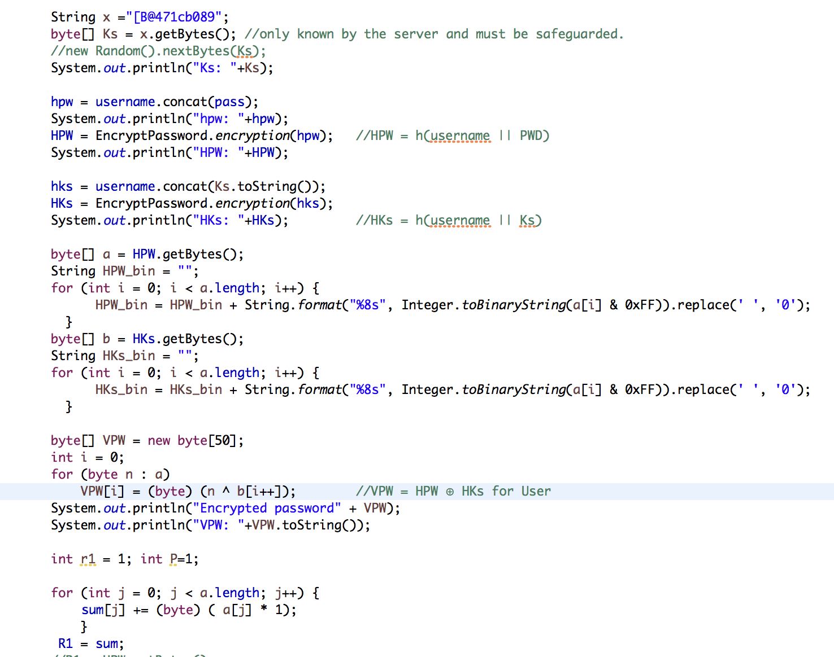
Code for Registration Phase

Slide 7
Authentication Phase
If a legal user wants to login into a Server, then the user is supposed to type the username and the password to authenticate.
Client User → Server: REQUEST (username, PW)
User generates r₁ and computes HPW and then
computes R₁ = (HPW.r₁)P
and sends it with a request message to Server.
Server → User: CHALLENGE (realm, R₂, h₁)
Server extracts HPW from VPW by computing HKs.
Then, Server computes R’₁ = HPW⁻¹ R₁ = (HPW⁻¹.HPW.r₁)P = r₁P
HPW⁻¹ is computed by Extended Euclidean Algorithm.
S generates r₂ and computes R₂ = r₂P, SKs = r₂R’₁ = r₂r₁P = r₁r₂P
and h₁ = h(SKs || R₂)
And SKs = r₂r₁P = r₁r₂P
SKs holds due to commutative property of elliptic curve group.
Finally, Server sends a challenge message to the User.

Slide 8
User → Server: RESPONSE (username, realm, h(username||realm||SKU))
When the User receives the CHALLENGE message,
user computes SKU = r₁R₂ = r₁r₂P and checks if h(SKU || R₂) = h₁
If TRUE, user authenticated the server and computes a message authentication code:
h(username || realm || SKU)
and then the user sends a response message to server:
RESPONSE (username, realm, h(username || realm || SKU))
Else user rejects the server challenge message.
After receiving the response message, Server computes h(username||realm||SKs) and verifies it with the received response h(username||realm||SKU).
If TRUE, Server authenticates user and accepts the User’s login request
Else, Server rejects the User response message.
SK = SKU = SKs = r₁r₂P is used as a shared session key after mutual authentication between User and the Server.

Slide 9
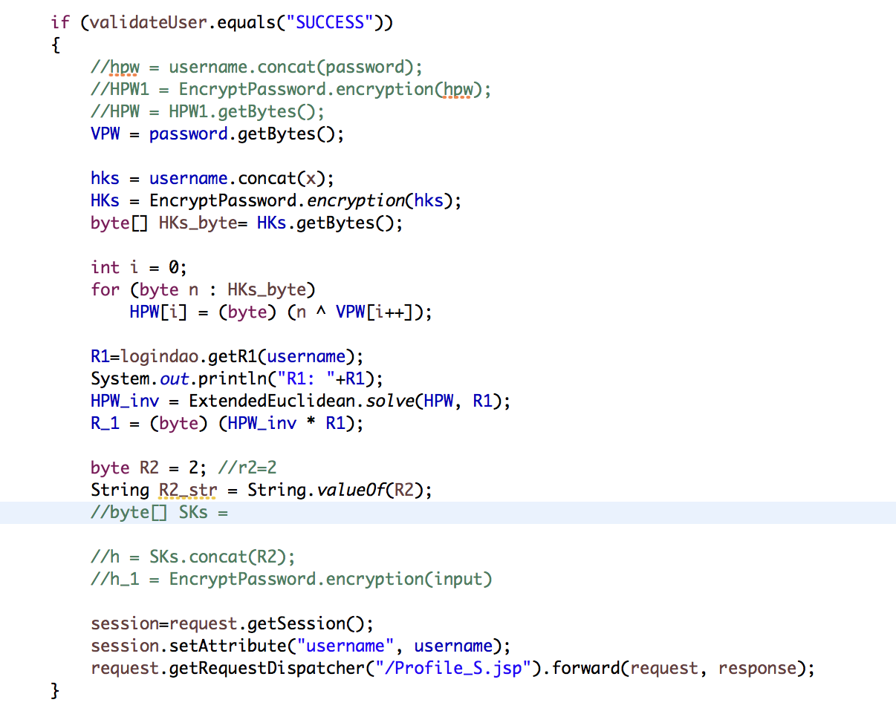
Code for Authentication Phase

Slide 10
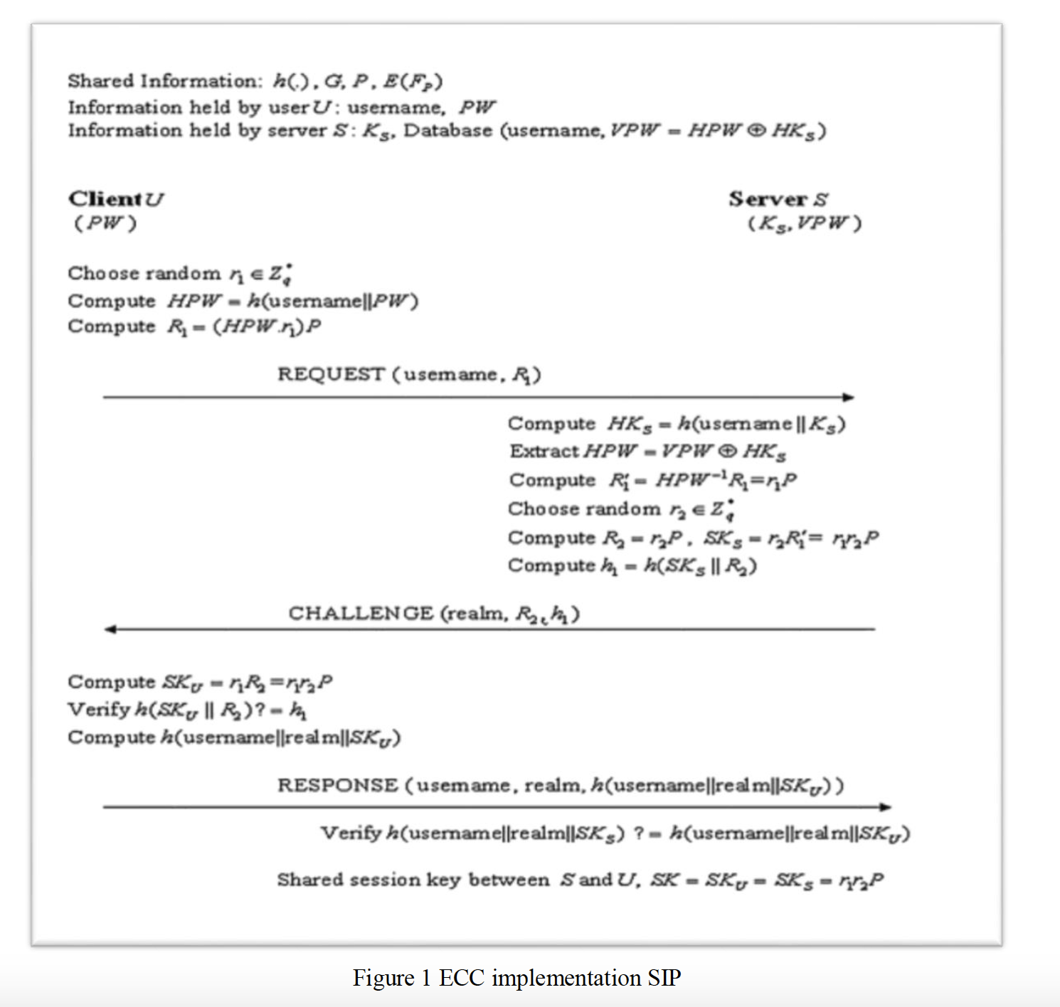
Proposed Procedure

Slide 11
Dataset

Slide 12
Comparisons between our protocol and the protocol of Arshad et al.
Computational Cost Analysis | Protocol of Arshad et al. | Our protocol
Computational cost (client) | 2TG_{mul} + 1T_{mul} + 3T_{h} | 3TG_{mul} + 3T_{h}
Computational cost (server) | 3TG_{mul} + 1T_{inv} + 3T_{h} + 1T_{XOR} | 3TG_{mul} + 3T_{h} + 1T_{XOR}
Resist off‐line password‐guessing attack | No | Yes

Slide 13
Security Properties
 | Tsai’s Scheme | Proposed Scheme
Replay attack | Secure | Secure
Password guessing attack | Insecure | Secure
Modification attack | Secure | Secure
Stolen-verifier attack | Insecure | Secure
Mutual Authentication | Provided | Provided
Session key security | Provided | Provided
Known key secrecy | Not Provided | Provided
Perfect forward secrecy | Not Provided | Provided

Slide 14
Notations
PWD: A low-entropy password of User extracted from D
D: A uniformly distributed dictionary of size |D|=2k, where 40≤k≤105
Ks: A high-entropy secret key of Server, which is only known by the server and must be safeguarded.
SKs: Secret Session Key
h: Secure one-way hash function, where h : {0; 1}* → {0; 1}l and l=160
||: Concatenation function
R₁ = (h(username || PWD).r₁)P
r₁ and r₂: nonce variables (randomly generated), which are protected by the ECDLP and ECCDHP and the secure one-way hash function
P: Point on the curve
ECCDHP: Elliptic Curve Computational Diffie-Hellman Problem
ECDLP: Elliptic Curve Discrete Logarithm Problem
ECDDHP: Elliptic Curve Decisional Diffie-Hellman Problem

Slide 15
Conclusion
In this paper, we have shown that the authentication scheme by Arshad et al. for session initiation protocol is vulnerable to the password‐guessing attack.
In order to resolve these security problems, we have proposed a novel and secure mutual authentication scheme based on the ECC.
The proposed authentication scheme not only resists these attacks but also provides greater security and efficiency.
Hence, our proposed authentication scheme is much better than any other previously proposed related schemes.

Slide 16
References
Arshad R, Ikram N. Elliptic curve cryptography based mutual authentication scheme for session initiation protocol. Multimedia Tools and Applications. DOI: 10.1007/s11042‐011‐0787‐0, 2011
Tsai J. Efficient nonce‐based authentication scheme for session initiation protocol. Int J Netw Secur 2009; 8(3): 312–316.
Yoon E, Yoo K, Kim C. A secure and efficient SIP authentication scheme for converged VoIP networks. Computer Communications 2010; 33: 1674–1681.
Wu L, Zhang Y, Wang F. A new provably secure authentication and key agreement protocol for SIP using ECC. Computer Standards and Interfaces 2009; 31(2): 286–291.
Code Reference:
http://ieeexplore.ieee.org/abstract/document/7582711/
https://link.springer.com/article/10.1007/s11042-011-0787-0#Sec18
https://github.com/DhruvDixitDD/ElGamal-based-Elliptic-Curve-Cryptography/blob/master/ElgamalEllipticCurve.py
https://stackoverflow.com/questions/13698624/sip-java-api-library

Slide 17
Thank You!

